Slide 1
Rock paper scissors
In Python programming language
By: Numair bin Rifau

Slide 2
Contents
Introduction
Python
Importing libraries
Libraries
Using random and time
Declaring variables
while loop
If statements
Input variables
Print statements
Break statements

Slide 3
Introduction
Using the programming language Python, we will recreate to a degree the timeless game of Rock, Paper and Scissors.
The game is simple game usually played by 2 people, in which each player simultaneously draws one of the three ‘weapons’ and the winner is determined by the order in which each weapon defeats and is defeated by the other weapons. Rock beats Scissors, and is beaten by Paper and Paper is defeated by Scissors.

Slide 4

PYTHON
Python is a high-level, object orientated programming language aimed for readability and is considered one of the easier ways any beginner could who finds themselves interested in programming to start their journey.

Slide 5


Importing libraries
We will start by importing the necessary libraries that we will use to make important parts of the game function as we would expect, first being the random library. This can be done by using import.
Next we will import the time library.
We will be using these libraries to give the code some extra functionality and for clarity while the code is running.

Slide 6

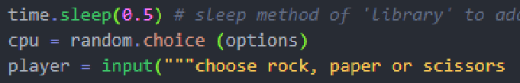
Libraries
Our time library will be used in the code to add a small delay before the next lines after are read and or displayed.
In this part of our code the .sleep method from our time library is called to give a delay of 0.5 seconds before our ‘cpu’ variable chooses its weapon and our player input function Is displayed.
Using the random library and its methods we can randomize parts of our code.
In this part the .choice method of random is called to choose randomly from our options tuple.

Slide 7
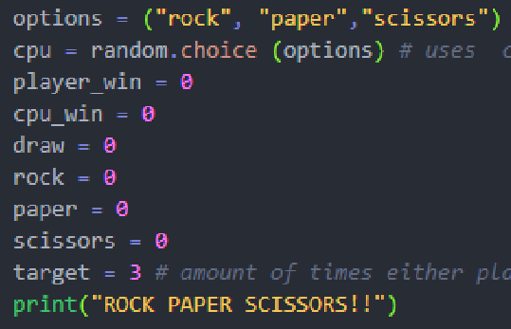
Declaring variables
Declaring our variables and giving them a base value, we can then update this value or use this value to manipulate our code later down the line by calling this variable.
We will declare a variable for every item
that we will want to call later on.

Slide 8
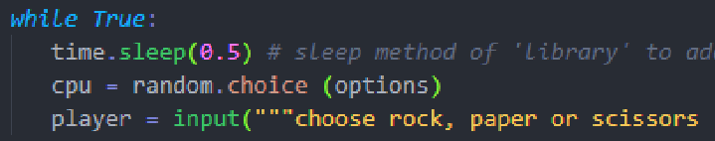
While loop
We will be using a while loop to contain the game arguments and replay the game after each turn till we reach a predefined target.
while True makes it so the code runs unless told otherwise.

Slide 9
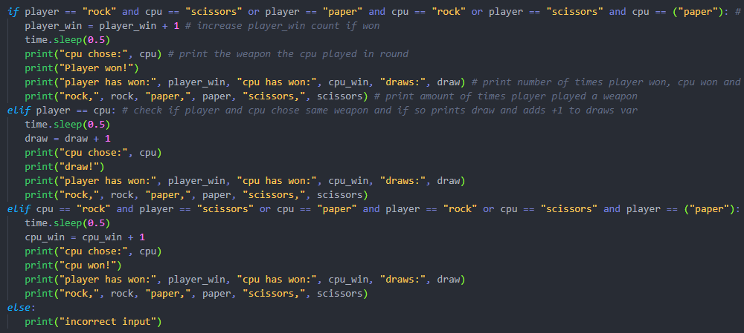
If statements
Using if, elif and else statements we can define the rules of the game.
The first if statement takes the player input, checks if it fulfilled the win arguments, and if so first adds +1 to player_win variable, then prints out the cpu input, prints “Player won!” then prints out how many times the player has won, the cpu has won and how many times the round has ended in a draw, as well as how many times the player has choses a specific weapon.
The first elif statement checks to see if the player weapon is equal to cpu weapon using a comparison operator. If they are the same the round ends in a draw.
The second elif statement checks to see it the cpu has won
The else statement runs if the player has not won, the cpu has not won and if the round did not end in a draw, and assumes the player did not input any of the defined weapons and prints out “incorrect input” to let the player know that their input is unrecognized

Slide 10


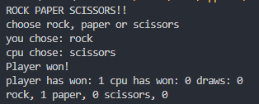
Input variables
Input variables can be used to prompt the user to make an input that will be used inside the code for arguments, functions, etc.

Slide 11
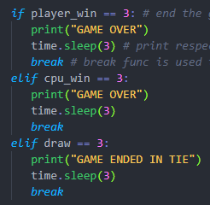
Break statement
The final statements check to see if either the variables player_win, cpu_win or draw is equal to a value of 3, and prints out the corresponding result, and using a break statement we break out of the loop and the game ends and the executable is closed after 3 seconds.

